Slide 1
Pipelined Protocol
Go-back-N Protocol
Selective Repeat Protocol

Slide 2
Performance of rdt3.0
rdt3.0 is correct, but performance stinks
e.g.: 1 Gbps link, 15 ms prop. delay, 8000 bit packet:
L
8000 bits
D_{trans} =
=
=
8 microsecs
R
10⁹ bits/sec
U _{sender}: utilization – fraction of time sender busy sending
if RTT=30 msec, 1KB pkt every 30 msec: 33kB/sec thruput over 1 Gbps link
network protocol limits use of physical resources!

Slide 3
rdt3.0: stop-and-wait operation
sender
receiver
first packet bit transmitted, t = 0
last packet bit transmitted, t = L / R
first packet bit arrives
RTT
last packet bit arrives, send ACK
ACK arrives, send next
packet, t = RTT + L / R

Slide 4
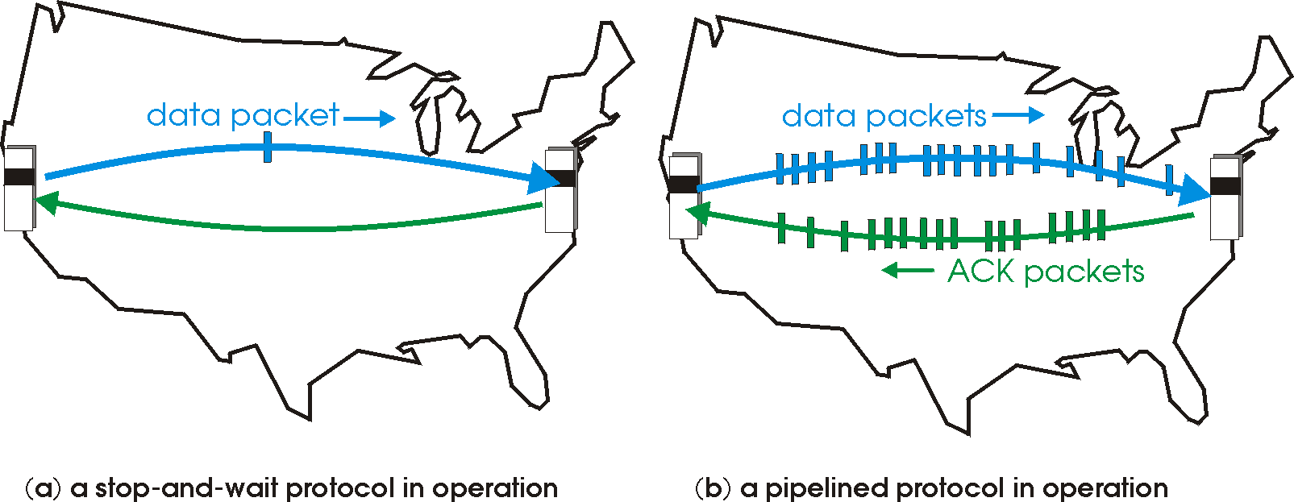

Pipelined protocols
pipelining: sender allows multiple, “in-flight”, yet-to-be-acknowledged pkts
range of sequence numbers must be increased
buffering at sender and/or receiver
two generic forms of pipelined protocols: go-Back-N, selective repeat

Slide 5
Pipelining: increased utilization
sender
receiver
first packet bit transmitted, t = 0
last bit transmitted, t = L / R
first packet bit arrives
RTT
last packet bit arrives, send ACK
last bit of 2nd packet arrives, send ACK
last bit of 3rd packet arrives, send ACK
ACK arrives, send next
packet, t = RTT + L / R
3-packet pipelining increases
utilization by a factor of 3!

Slide 6
Pipelined protocols: overview
Go-back-N:
sender can have up to N unacked packets in pipeline
receiver only sends cumulative ack
doesn’t ack packet if there’s a gap
sender has timer for oldest unacked packet
when timer expires, retransmit all unacked packets
Selective Repeat:
sender can have up to N unack’ed packets in pipeline
rcvr sends individual ack for each packet
sender maintains timer for each unacked packet
when timer expires, retransmit only that unacked packet

Slide 7
Pipelined Protocol
Its a technique in which multiple requests are written out to a single socket without waiting for the corresponding responses (acknowledged).
No. of Packets(request) must be increased.
Data or Packet should be buffered at sender and/or receiver.
Two generic forms of pipelined protocols:
Go-back-N
Selective Repeat

Slide 8
Go-back-N Protocol
Sender can have up to N unacked packets in pipeline.
Receiver only sends cumulative ACK. It doesn’t ACK packet if there’s a gap.
Sender has timer for oldest unacked packet.
When timer expires, retransmit all unacked packets.
Sender send a number of frames specified by a window size even without receiving an ACK packet from the receiver.

Slide 9
Go-back-N Protocol Cont…
Receiver keeps track of the sequence no. of the next frame it expects to receive, and sends that number with every ACK it sends.
Receiver will discard any frame that does not have the exact sequence number it expects.
Either a duplicate frame it already ACKed OR
An out-of-order frame it expects to receive later
Receiver will resend an ACK for the last correct in-order frame.
Once the sender has sent all of the frames in its window. It will detect that all of the frames since the first lost frame are outstanding.
Then go back to the sequence number of the last ACK it received from receiver.
Go-back-N protocol also known as sliding window protocol.

Slide 10

Go-back-N Protocol works
sender window (N=4)
0 1 2 3 4 5 6 7 8
send pkt0
send pkt1
send pkt2
send pkt3
(wait)
0 1 2 3 4 5 6 7 8
receive pkt0, send ack0
receive pkt1, send ack1
receive pkt3, discard,
(re)send ack1
0 1 2 3 4 5 6 7 8
X
0 1 2 3 4 5 6 7 8
loss
0 1 2 3 4 5 6 7 8
rcv ack0, send pkt4
rcv ack1, send pkt5
0 1 2 3 4 5 6 7 8
receive pkt4, discard,
(re)send ack1
ignore duplicate ACK
receive pkt5, discard,
(re)send ack1
pkt 2 timeout
0 1 2 3 4 5 6 7 8
send pkt2
send pkt3
send pkt4
send pkt5
0 1 2 3 4 5 6 7 8
0 1 2 3 4 5 6 7 8
rcv pkt2, deliver, send ack2
rcv pkt3, deliver, send ack3
rcv pkt4, deliver, send ack4
rcv pkt5, deliver, send ack5
0 1 2 3 4 5 6 7 8

Slide 11
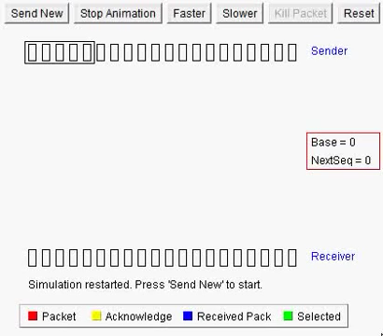
Go-back-N Visualization

Slide 12
Selective Repeat

Slide 13
Selective Repeat
A sender can have up to N unACKed packets in pipeline.
Receiver sends individual ACK for each packet.
Sender maintains timer for each unACKed packet.
When timer expires, retransmit only that unACKed packet.

Slide 14
Selective Repeat
Selective Repeat attempts to retransmit only those packets that are actually lost due to errors.
Receiver must be able to accept packets out of order.
Since receiver must release packets to higher layer in order, the receiver must be able to buffer some packets.
The receiver acknowledges every good packet, packets that are not ACKed before a time-out are assumed lost or in error.
This approach must be used to be sure that every packet is eventually received.
An explicit NAK (selective reject) can request retransmission of just one packet.

Slide 15
Selective Repeat Works
sender window (N=4)
sender
receiver
0 1 2 3 4 5 6 7 8
send pkt0
send pkt1
send pkt2
send pkt3
(wait)
0 1 2 3 4 5 6 7 8
receive pkt0, send ack0
receive pkt1, send ack1
receive pkt3, buffer,
send ack3
0 1 2 3 4 5 6 7 8
X
0 1 2 3 4 5 6 7 8
loss
0 1 2 3 4 5 6 7 8
rcv ack0, send pkt4
rcv ack1, send pkt5
0 1 2 3 4 5 6 7 8
receive pkt4, buffer,
send ack4
record ack3 arrived
receive pkt5, buffer,
send ack5
pkt 2 timeout
0 1 2 3 4 5 6 7 8
send pkt2
0 1 2 3 4 5 6 7 8
record ack4 arrived
0 1 2 3 4 5 6 7 8
rcv pkt2;
deliver pkt2,pkt3, pkt4, pkt5;
send ack2
record ack5 arrived
0 1 2 3 4 5 6 7 8
Q: what happens when ack2 arrives?

Slide 16
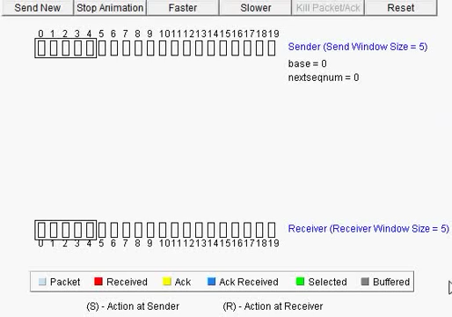
Selective Repeat Visualization

Slide 17
TCP Segment Structure

Slide 18
TCP Segment Structure
32 bits
URG: urgent data
(generally not used)
counting
by bytes
of data
(not segments)
source port #
dest port #
sequence number
ACK: ACK #
valid
acknowledgement number
head
len
not
used
U
receive window
A
PSH: push data now
(generally not used)
P
R
S
F
# bytes
receiver
willing
to accept
checksum
Urg data pointer
RST, SYN, FIN:
connection establish
(setup, teardown
commands)
options (variable length)
application
data
(variable length)
Internet
checksum
(as in UDP)
Transport Layer
3-18

Slide 19
TCP Segment – Cont…
The unit of transmission in TCP is called segments.
The header includes source and destination port numbers, which are used for multiplexing/demultiplexing data from/to upper-layer applications.
The 32-bit sequence number field and the 32-bit acknowledgment number field are used by the TCP sender and receiver in implementing a reliable data transfer service.
The sequence number for a segment is the byte-stream number of the first byte in the segment.
The acknowledgment number is the sequence number of the next byte a Host is expecting from another Host.

Slide 20
TCP Segment – Cont…
The 4-bit header length field specifies the length of the TCP header in 32-bit words. The TCP header can be of variable length due to the TCP options field.
The 16-bit receive window field is used for flow control. It is used to indicate the number of bytes that a receiver is willing to accept.
The 16-bit checksum field is used for error checking of the header and data.
Unused 6 bits are reserved for future use and should be sent to zero.
Urgent Pointer is used in combining with the URG control bit for priority data transfer. This field contains the sequence number of the last byte of urgent data.

Slide 21
TCP Segment – Cont…
Data: The bytes of data being sent in the segment.
URG (1 bit): indicates that the Urgent pointer field is significant.
ACK (1 bit): indicates that the Acknowledgment field is significant.
PSH (1 bit): Push function. Asks to push the buffered data to the receiving application.
RST (1 bit): Reset the connection.
SYN (1 bit): Synchronize sequence numbers. Only the first packet sent from each end should have this flag set. Some other flags and fields change meaning based on this flag, and some are only valid for when it is set, and others when it is clear.
FIN (1 bit): No more data from sender.

Slide 22
Thank You

